Slide 1
IMAGE SEGMENTATION
Presented By:
Aditya Kumar 181112251
Pradhi Anil Kumar Das 181112252
Aaron Paul 181112287
Pushpak Manani 181112286

Slide 2
ABSTRACT
Image Segmentation is the process by which a digital image is partitioned into various subgroups (of pixels) called Image Objects. The goal of segmentation is to simplify and/or change the representation of an image into something that is more meaningful and easier to analyze.Image segmentation is typically used to locate objects and boundaries in images.

Slide 3
WHAT IS IMAGE SEGMENTATION?
Image Segmentation is the process by which a digital image is partitioned into various subgroups (of pixels) called Image Objects, which can reduce the complexity of the image, and thus analysing the image becomes simpler.
The image segmentation algorithms try to collect similar pixels together and separate out dissimilar pixels. This is done by following two approaches based on the image properties:
i) Similarity Detection (Region Approach)
ii) Discontinuity Detection (Boundary Approach)

Slide 4
RPoints to include
Image Processing on Medical X-rays of Lungs to detect covid’19
Deep cnn based neural network
Dataset collection from kaggle
Data preparation
Data Visualisation
How neural networks and deep learning help in the detection of covid
Training dataset and testing dataset
Convolutional Neural Network
Code
Images
Resources

Slide 5
Applications of Image Segmentation:
There are countless applications that can be implemented with the help of image segmentation.Our group will try to implement some of these applications of image segmentation.
Improved Quality of MRI/Medical images for better detection of diseases and problems
Lane detection used for vehicle navigation, lateral control, collision prevention, or lane departure warning system.
Generic object segmenting images can help to improve robot vision
Image segmentation can also be applied to satellite images in order to get better object detection

Slide 6
Generic Object Segmentation
Object detection, one of the most fundamental and challenging problems in computer vision, seeks to locate object instances from a large number of predefined categories in natural images.
The main use of generic object detection is in the field of computer vision . Computer vision is an interdisciplinary scientific field that deals with how computers can gain high-level understanding from digital images or videos. From the perspective of engineering, it seeks to understand and automate tasks that the human visual system can do.

Slide 7
Methodology:
Generic Object Segmentation: The K-means algorithm is an iterative technique that is used to partition an image into K clusters.The basic algorithm is 1.Pick K cluster centers, either randomly or based on some heuristic method. 2.Assign each pixel in the image to the cluster that minimizes the distance between the pixel and the cluster center 3.Re-compute the cluster centers by averaging all of the pixels in the cluster 4.Repeat steps 2 and 3 until convergence is attained (i.e. no pixels change clusters)
In this case, distance is the squared or absolute difference between a pixel and a cluster center. This algorithm is guaranteed to converge, but it may not return the optimal solution. The quality of the solution depends on the initial set of clusters and the value of K.

Slide 8
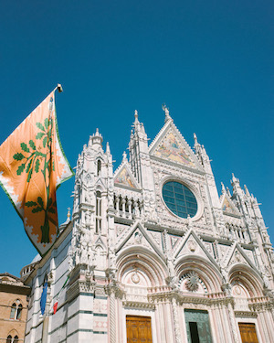
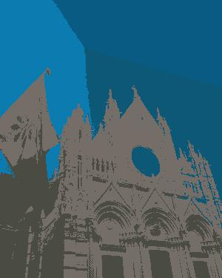
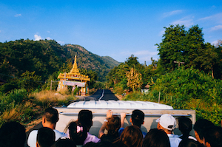
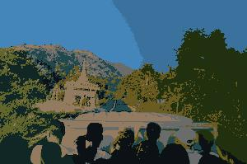
Results:
a)k=5 in this case b)k=8 in this case

Slide 9
Medical Image Enhancement
Medical imaging is the process of producing visible images of inner structures of the body for scientific and medicinal study and treatment as well as a visible view of the function of interior tissues. This process pursues the disorder identification and management.
This process includes both organic and radiological imaging which used electromagnetic energies (X-rays and gamma), sonography, magnetic, scopes, and thermal and isotope imaging. There are many other technologies used to record information about the location and function of the body. Those techniques have many limitations compared to those modulates which produce images.
The goal of my program is to use image segmentation on medical MRI images to improve the contrast and segment the different parts of the image to for better detection of tumors ,diseases and anomalies.

Slide 10
Methodology:
This program uses K-NN algorithm in order to segment the MRI scans
The steps Involved in my algorithm are:
Main Algorithm working:
1.Choosing the number of Clusters(n) and using k-means to make the classes
2.kmeans centers points for centroid.
3.Assigning each Data point or as we say each pixel value to the above centroid using KNN that further gives us clusters.
4.In our case 41 was passed as the number of neighbors(Odd number to break tie)
5.On the last step we just do the concatenation of original and segmented image

Slide 11

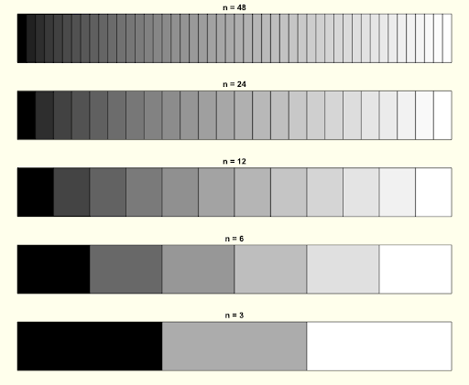
Conversion of Grayscale to New Scale(Depending on value of n) for Segmentation
Notes:
I used BGR scale for better contrast.

Slide 12
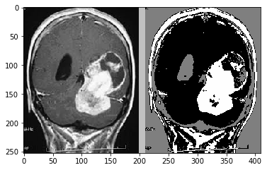
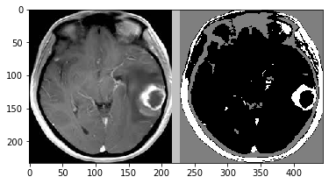
Results:
Example 1:Left hand side is the input MRI scan and the Right hand side is the output segmented MRI scan
Example 2:Left hand side is the input MRI scan of a tumor in the brain and the Right hand side is the output segmented MRI scan

Slide 13
Lane Detection
Lane detection is the process of locating lane markers on the road and presenting these locations to an intelligent system. The applications of a lane detecting system could be as simple as pointing out lane locations to the driver on an external display, to more complicated tasks such as predicting a lane change in the immediate future in order to avoid potential collisions with other vehicles. Some of the interfaces used to detect lanes include cameras, laser range images, LIDAR and GPS devices. Our method relies on the use of Dash cam cameras to accomplish the task.

Slide 14
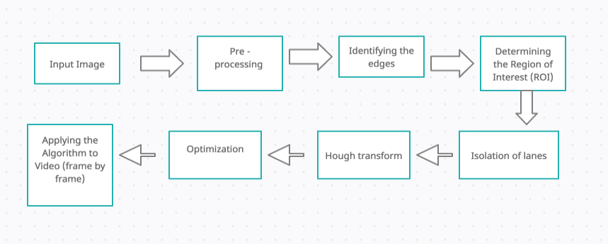
Methodology:
1) First we start by pre processing the image, which includes converting the input image frame (RGB) to gray scale for reducing the channels. Then we smoothen the Image.
2) Identification of edges: We use one of the edge detection techniques called the Canny Technique, which will help us identify the edges in the image.
3) Determining the region of Interest (ROI ) : Before we start detection, we need to decide the particular lane area in the image that we should work-on to write the program. For this we create a ROI function which returns the enclosed region of our field of view, in the case of a road, triangle region would be best fit. We do so by creating a polygon and applying it on a black mask.

Slide 15
4) Isolation of lanes : Now, we will need to isolate the lanes in the masked portion of the image. We use binaries to isolate. We apply Bitwise AND between the existing image and the gradient image. Doing so will give us perfectly masked out lanes on the road.
5) Hough Transform : Hough Transform will help us to detect the straight lines in the image and help identifying Lane lines. Hough space is the representation of the b,m axis in the Line equation y=mx+b.
6) Optimization : We see that the resulting image contains multiple lines having breakpoints in between certain lanes, We can fix this by taking average of their slope and the y intercept to form a single line that will trace a whole lane, thereby optimizing the preview.
7) Applying the Algorithm to a video frame by frame : We will use opencv’s VideoCapture function, which will allow us to process the video frame by frame by reading every frame and then applying the algorithm to that particular frame.

Slide 16
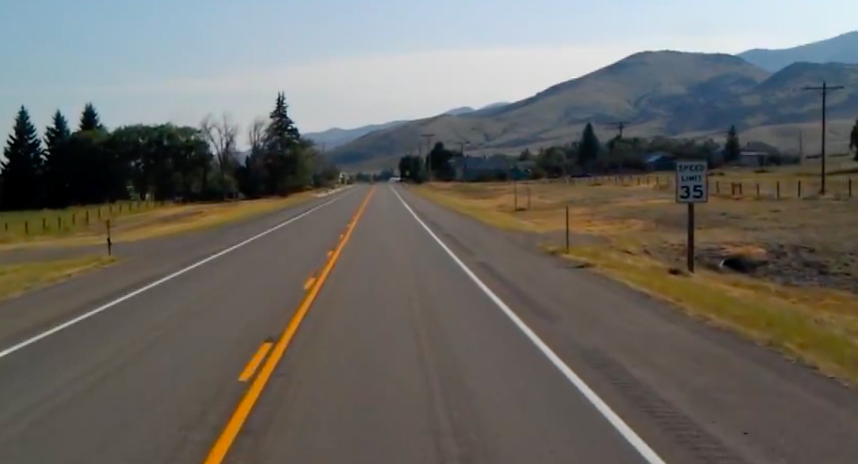
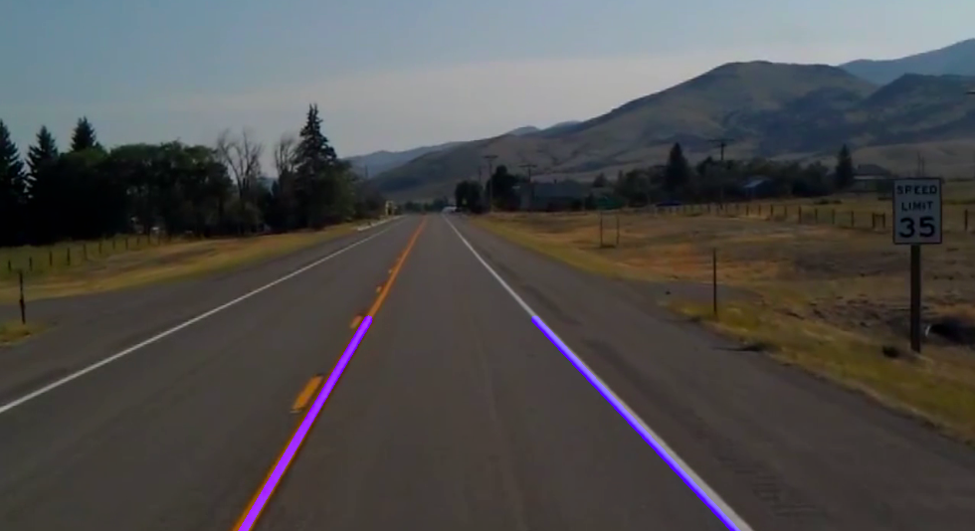
Result of Lane Detection Program:
Original Input Frame
Output Frame with detection

Slide 17
LANE DETECTION VIDEO OUTPUT
The output video can be found on this link : https://www.youtube.com/watch?v=kikCMDAUhKU

Slide 18
Road segmentation using Satellite images:
Semantic segmentation is the process of classifying each pixel of an image into distinct classes using deep learning. This aids in identifying regions in an image where certain objects reside.
This aim of this project is to identify and segment roads in aerial imagery. Detecting roads can be an important factor in predicting further development of cities and also segmentation of roads is important to map-based applications and is used for finding distances or shortest routes between two places.

Slide 19
Methodology:
1. Dataset : For this we used the “Massachusetts Roads Dataset”. This dataset contains 1171 aerial images, along with their target masks. Both the masks and the images are 1500x1500 in the resolution are present in the “.tiff” format.
2. Manipulating the data : The pre-processing steps involved:
Removing images where more than 25% of the map was missing.
Cropped 256x256 images out of the images. Hence, increasing the total number of images to more than 22,000.
Binarized the mask so that the pixel value is always between 0 and 1.

Slide 20
3. Model : We used an Unet, which is a FCN (fully convolutional network) , with three cross-connections. Adam optimiser with a learning rate of 0.00001 was used, along with dice loss (because of the unbalanced nature of the dataset) .

Slide 21
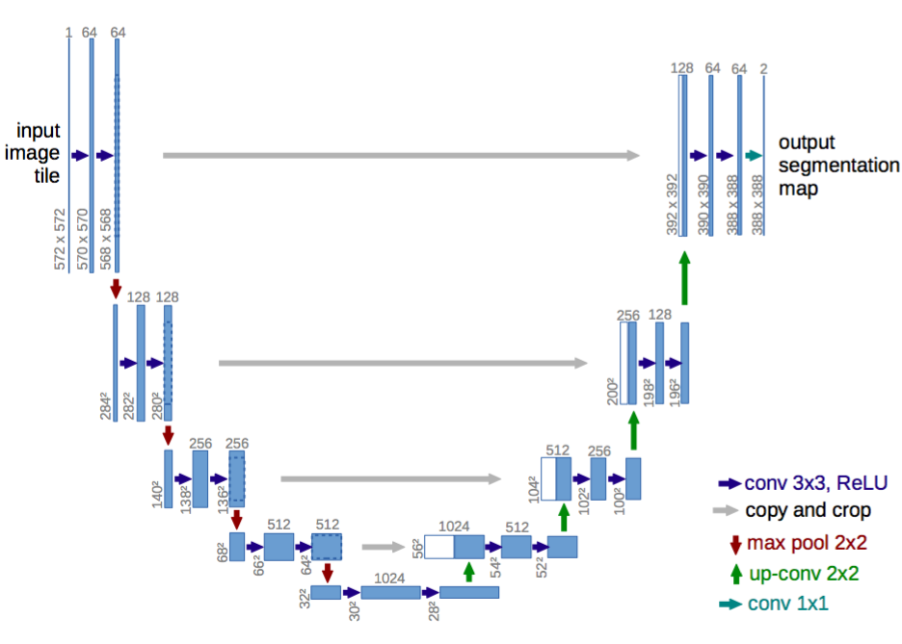
U-Net architecture :

Slide 22
The U-net is a FCN (Fully Convolutional Network)
FCN was developed for biomedical image segmentation at the Computer Science Department of the University of Freiburg, Germany
These networks can perform multiclass segmentation of any kind of object — be it segmenting people, cars or even buildings.
Network Architecture
Network takes a 256x256 multichannel image and outputs a single-channel map of the same dimension

Slide 23
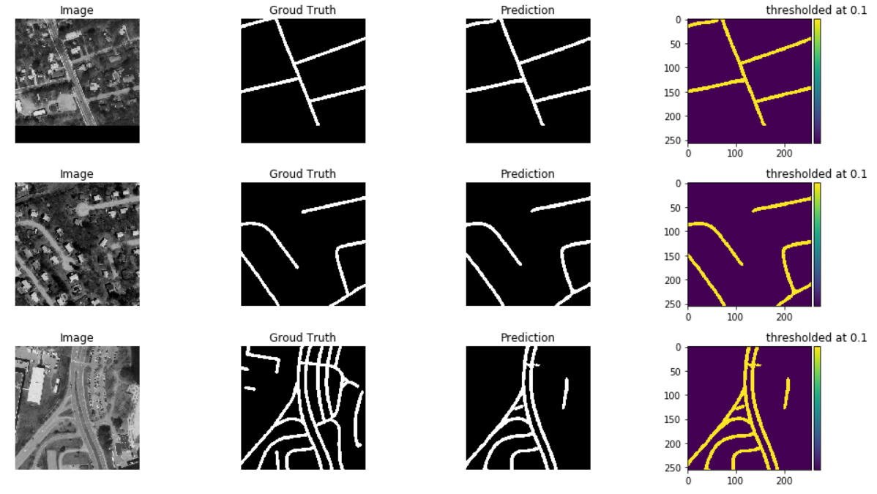
Results:

Slide 24
Results :
The model trained for 57 epochs before earl stopper kicked in and killed the training process. A validation dice loss of 0.235 was achieved.
For some aerial images, the model was able to predict the mask exactly same as that in the ground truth.
For some aerial images, the model was able to predict the mask 60-70% of that in the ground truth.
And for some aerial images, the model was able to predict the mask better than that provided in the ground truth.
It can be concluded that the model proves to be reliable for further predictions.

